Slide 1
Identifying Audit Processes for Automation using RPA
Presented By: Hongmin William Du
Notes:
Introduction Slide
Hello everyone, I’m William Du and I’m currently a second year PhD student here at Rutgers. Today I wanted to present to you guys today a framework for identifying audit process that are suitable for robotic process automation.

Slide 2
Robotic Process Automation (RPA)
What is RPA ?
A programmed software that uses business rules and predefined activities to automate the execution of a combination of processes, activities, transactions and tasks
Notes:
What is RPA slide?
I wanted to start off with introducing RPA first. I’m sure most of you in this room have already been introduced or exposed to the concept of RPA. So, I wanted to briefly introduce it to those who haven’t. RPA is a preprogrammed software that uses business rules and predefined activities to automate the execution of a combination of processes, activities, transactions and tasks. Basically, RPA are robots who can reperform repetitive human tasks.
RPA has a huge potential in auditing. Manual and repetitive audit tasks such as reconciliations, internal control testing, and substantive testing can be automated. The automation of these task would allow auditors to allocate more of their time and resources to audit areas that are more complex and spend time on items that are more prone to risk leading to higher audit quality.

Slide 3
Where is RPA most applicable?
RPA can aid auditors in various parts in the audit process such as
Reconciliations and substantive testing
Assessments of Internal Controls
Risk Assessment
Substantive Testing
Which audit processes are suitable for automation?
Notes:
Where is RPA most applicable slide?
So where is RPA the most applicable in auditing? Because audit processes are complex in nature, not all audit procedures are suitable for RPA. So the question that I want to address in this presentation is to determine which audit processes if even a part of the process are suitable for automation.

Slide 4
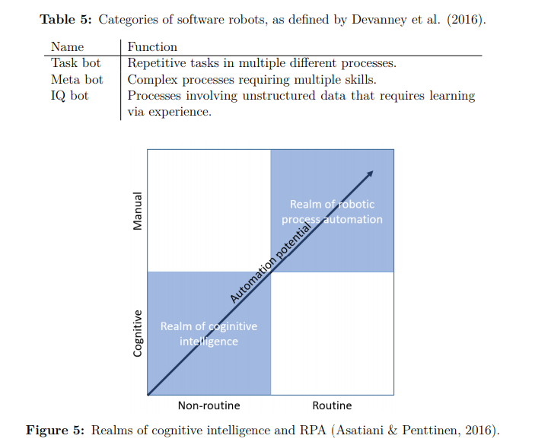
Notes:
Chart
I wanted to show you this graph today introduced by Devanney which shows the realm of cognitive intelligence and the realm of robotic process automation. Cognitive intelligence uses learning from experience, such as artificial intelligence. These are typically less routine as the robot will change as it learns from more experience. However, as you enter the realm of robotic process automation which is more manual and more routine, the potential for automation increases significantly.
Software robots are defined into three categories. Task bot, Meta bot, and IQ bot. Task bot is typically fall under the realm of Robotic Process Automation. IQ bots would be more of artificial intelligence bots that would lie in the realm of cognitive intelligence. And Meta bots would fall in the middle between robotic process automation and cognitive intelligence.

Slide 5
Characteristics of Tasks Suitable for Automation
Characteristics:
High volume
Repetitive
Time consuming
Prone to error
Stable Environment
Notes:
Characteristics of Tasks Suitable for Automation
For the purpose of my framework, I first want to define characteristics of tasks that are suitable for automation. These characteristics usually include activities that are high in volume, repetitive, time consuming, prone to error.

Slide 6
Overview of Framework
Notes:
Overview of the Framework
Now I wanted to introduce my framework
Since Audit processes and plans may be different based on each firm and for each engagement, the starting point in my framework is to first choose the audit process.

Slide 7
Step 1: Segment the Process
Segment the Audit Processes into several distinct activities
The goal of this step is to attempt to separate the simpler activities from the more complex activities in the process
Notes:
Step 1
Once we have selected our audit process, we want to first segment the audit process into several distinct activities. The goal of this step is to separate the simpler more automatable activities from the more complex activities in the process.

Slide 8
Step 2: Classify the segments
Assign classifications based on the characteristics for each activity
Examples of characteristics:
High volume
Complex
Simple
Repetitive
Time consuming
Prone to error
Notes:
Step 2
Then once we have segmented our audit process into several distinct activities, we can then assign classifications based on the characteristics to each activity. Earlier I introduced the characteristics for tasks that are suitable for automation. Here the characteristics for classifications could include characteristics for automation and characteristics for more complex tasks.

Slide 9
Step 3: Compare the Characteristics
Compare the assigned characteristics to the set of characteristics for activities that are best suitable for automation
Characteristics best suitable for automation:
High volume
Stable Environment
Repetitive
Time consuming
Prone to error
Notes:
Step 3
Then once each segment has been assigned characteristics, we can compare the assigned characteristics to the set of characteristics that are most suitable for automation.

Slide 10
Step 4: Identify which segments have the highest potential for automation
Based on the comparison of characteristic, identify which segments of the process have the highest suitability for automation
Notes:
Step 4
Then based on the comparison of characteristics, we can identify which segments of the process have the highest suitability for automation

Slide 11
Step 5: Simulate and Test the Automation of the selected segment
Finally we can simulate and test the automation of the selected segment using software's such as Ui Path or Automation Anywhere
If we find that the entire segment is not automatable, we can go back to step 1 and resegment the process
Notes:
Step 5
Finally, in step 5, we can simulate and test the automation of each selected segment using software’s such as Ui Path or Automation Anywhere. And if we find that some of the segments are not entirely automatable, we can go back to step 1 to resegment the process into activities that better separate the automatable activities from the complex activities.

Slide 12
Thank You!

